Slide 1
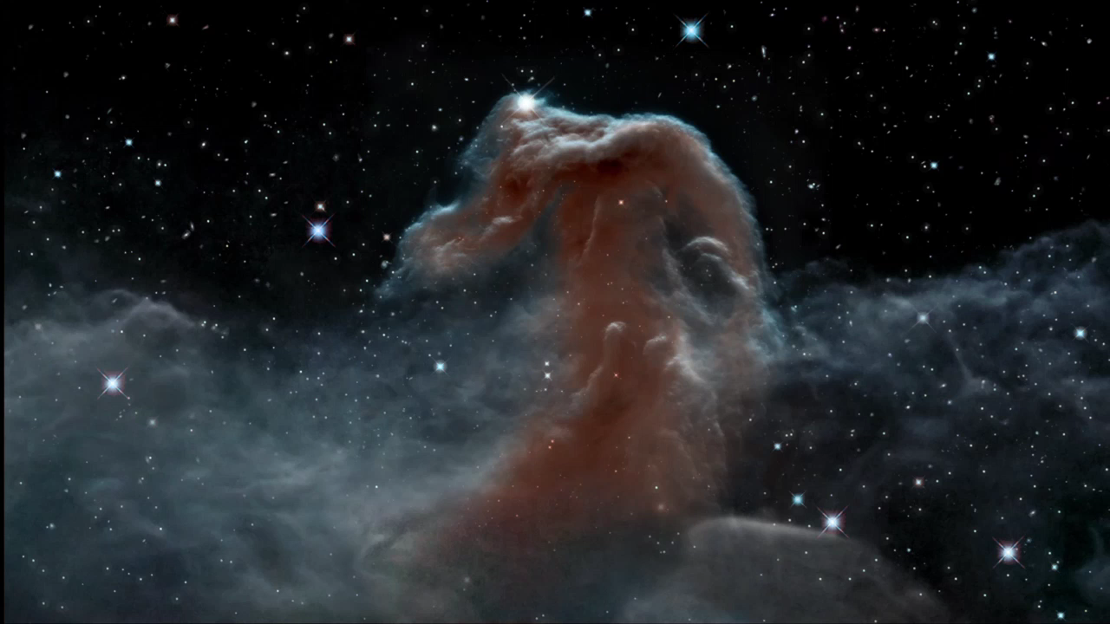
Notes:
The Horsehead Nebula in Infrared
This visualization explores Hubble's infrared view of the Horsehead Nebula. The three-dimensional interpretation has been sculpted into a wispy and mountainous environment, with stars distributed in a statistical manner. This imaginative traverse of the glowing gaseous landscape provides an inspiring spaceflight experience that brings the celestial scene to life.

