Slide 1
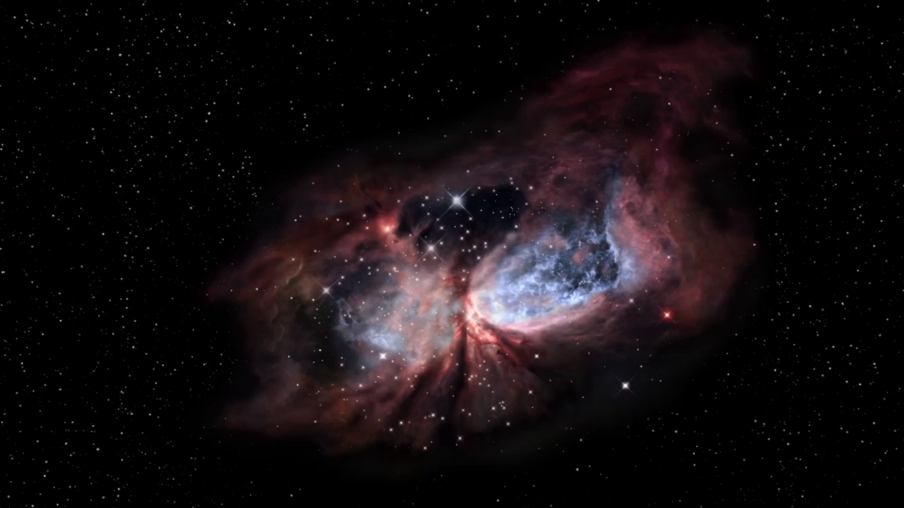
Notes:
Star-Forming Region Sharpless 2-106
This three-diensional visualization of the star-forming region illustrates and emphasizes that many of the objects contained within astronomical images are not at the same distance, but, in fact, spread across light-years of space. The stars and the lobes of glowing gas from the Hubble two-dimensional image have been separated and sculpted using both scientific knowledge and artistic license to create the landscape and depth in the movie.

