Slide 1
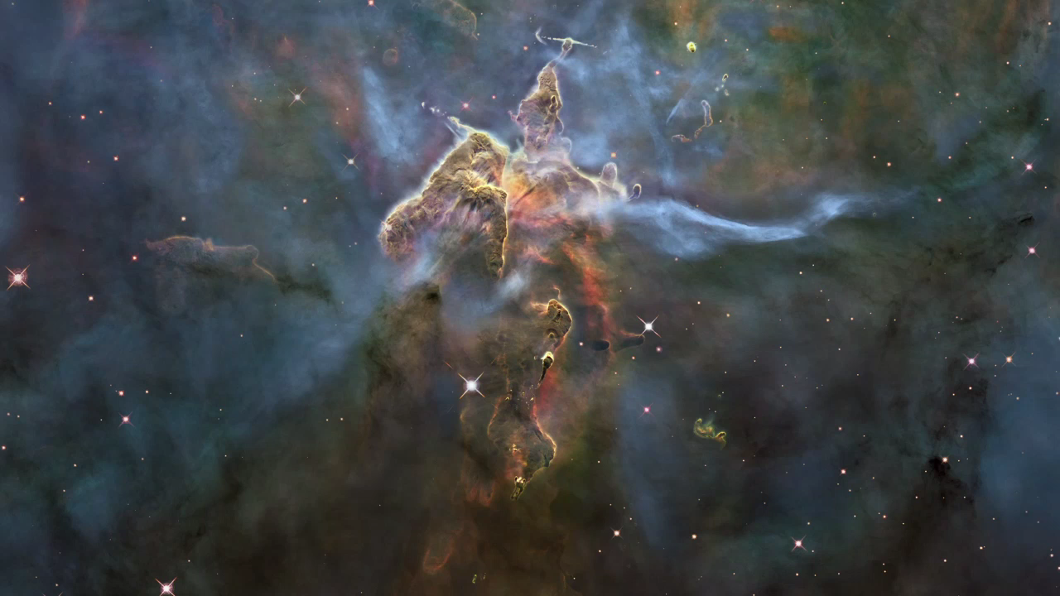
Notes:
Mystic Mountain
This visualization flies into a giant "mountain" of cool hydrogen and dust in the Carina Nebula, a vast star-forming region in our Milky Way Galaxy. At the top of the highest "peak" of the gas one can see jets emitted by a newborn star. The nebula is too far away for the Hubble Space Telescope to see in true three dimensions, but this visualization creates foreground and background elements based on an approximation of how the stars and gas might be distributed inside the region.

