Slide 1
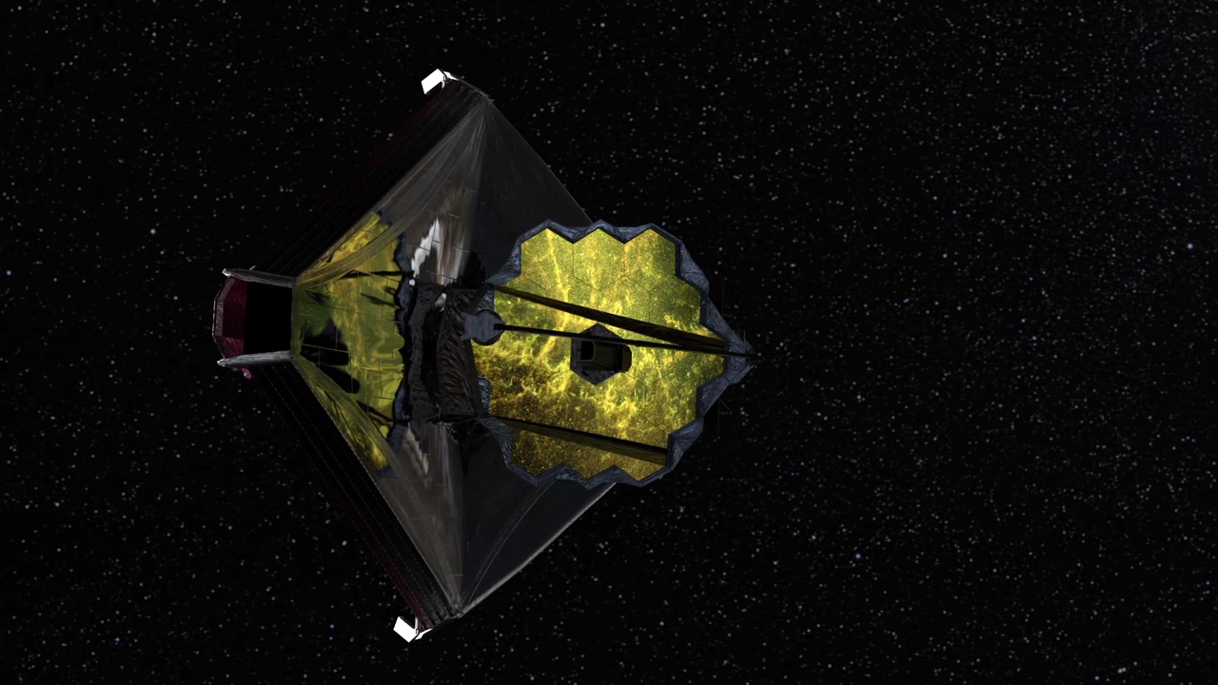
Notes:
James Webb Space Telescope
This animation pans past a model of JWST at the second LaGrange point (L2). The opening of the sequence illustrates the L2 location, showing Earth in the mid-ground, and the Sun in the background. Later in the sequence, notice the reflection of the secondary mirror sweeping across the primary mirror.

