Slide 1
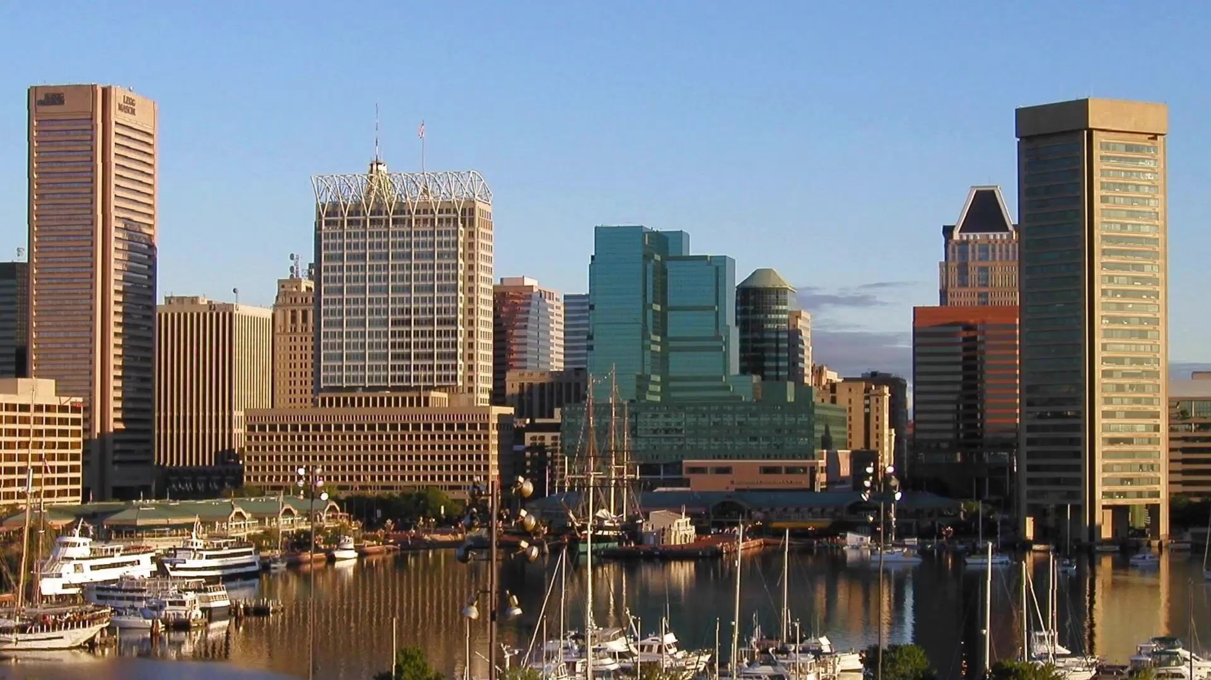
Notes:
A Black Hole Visits Baltimore
This scientific visualization demonstrates the visual distortion known as gravitational lensing. A black hole, with roughly the mass of the planet Saturn, is imagined to pass over the Inner Harbor in Baltimore, MD. The view of the buildings on the far side of the harbor are distorted using the calculated effects of Einstein's general relativity.

