Slide 1
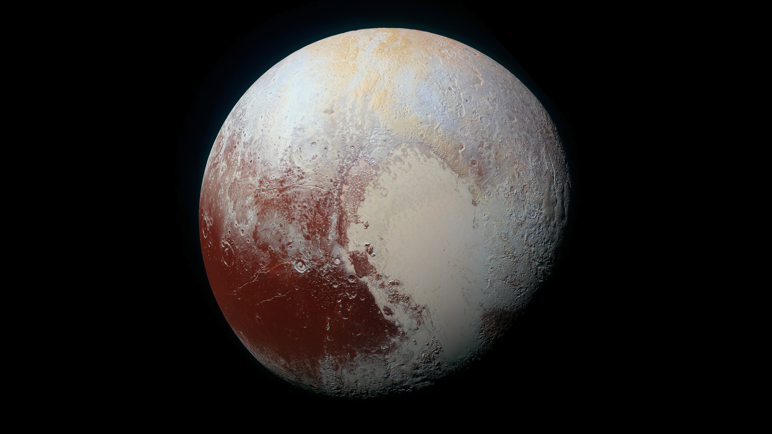
Notes:
The Rich Color Variations of Pluto
NASA's New Horizons spacecraft captured this high-resolution enhanced color view of Pluto on July 14, 2015. The image combines blue, red and infrared images taken by the Ralph/Multispectral Visual Imaging Camera (MVIC). Pluto's surface sports a remarkable range of subtle colors, enhanced in this view to a rainbow of pale blues, yellows, oranges, and deep reds. Many landforms have their own distinct colors, telling a complex geological and climatological story that scientists have only just begun to decode. The image resolves details and colors on scales as small as 0.8 miles (1.3 kilometers).
For more information, see:
photojournal.jpl.nasa.gov/catalog/PIA19952

