Slide 1
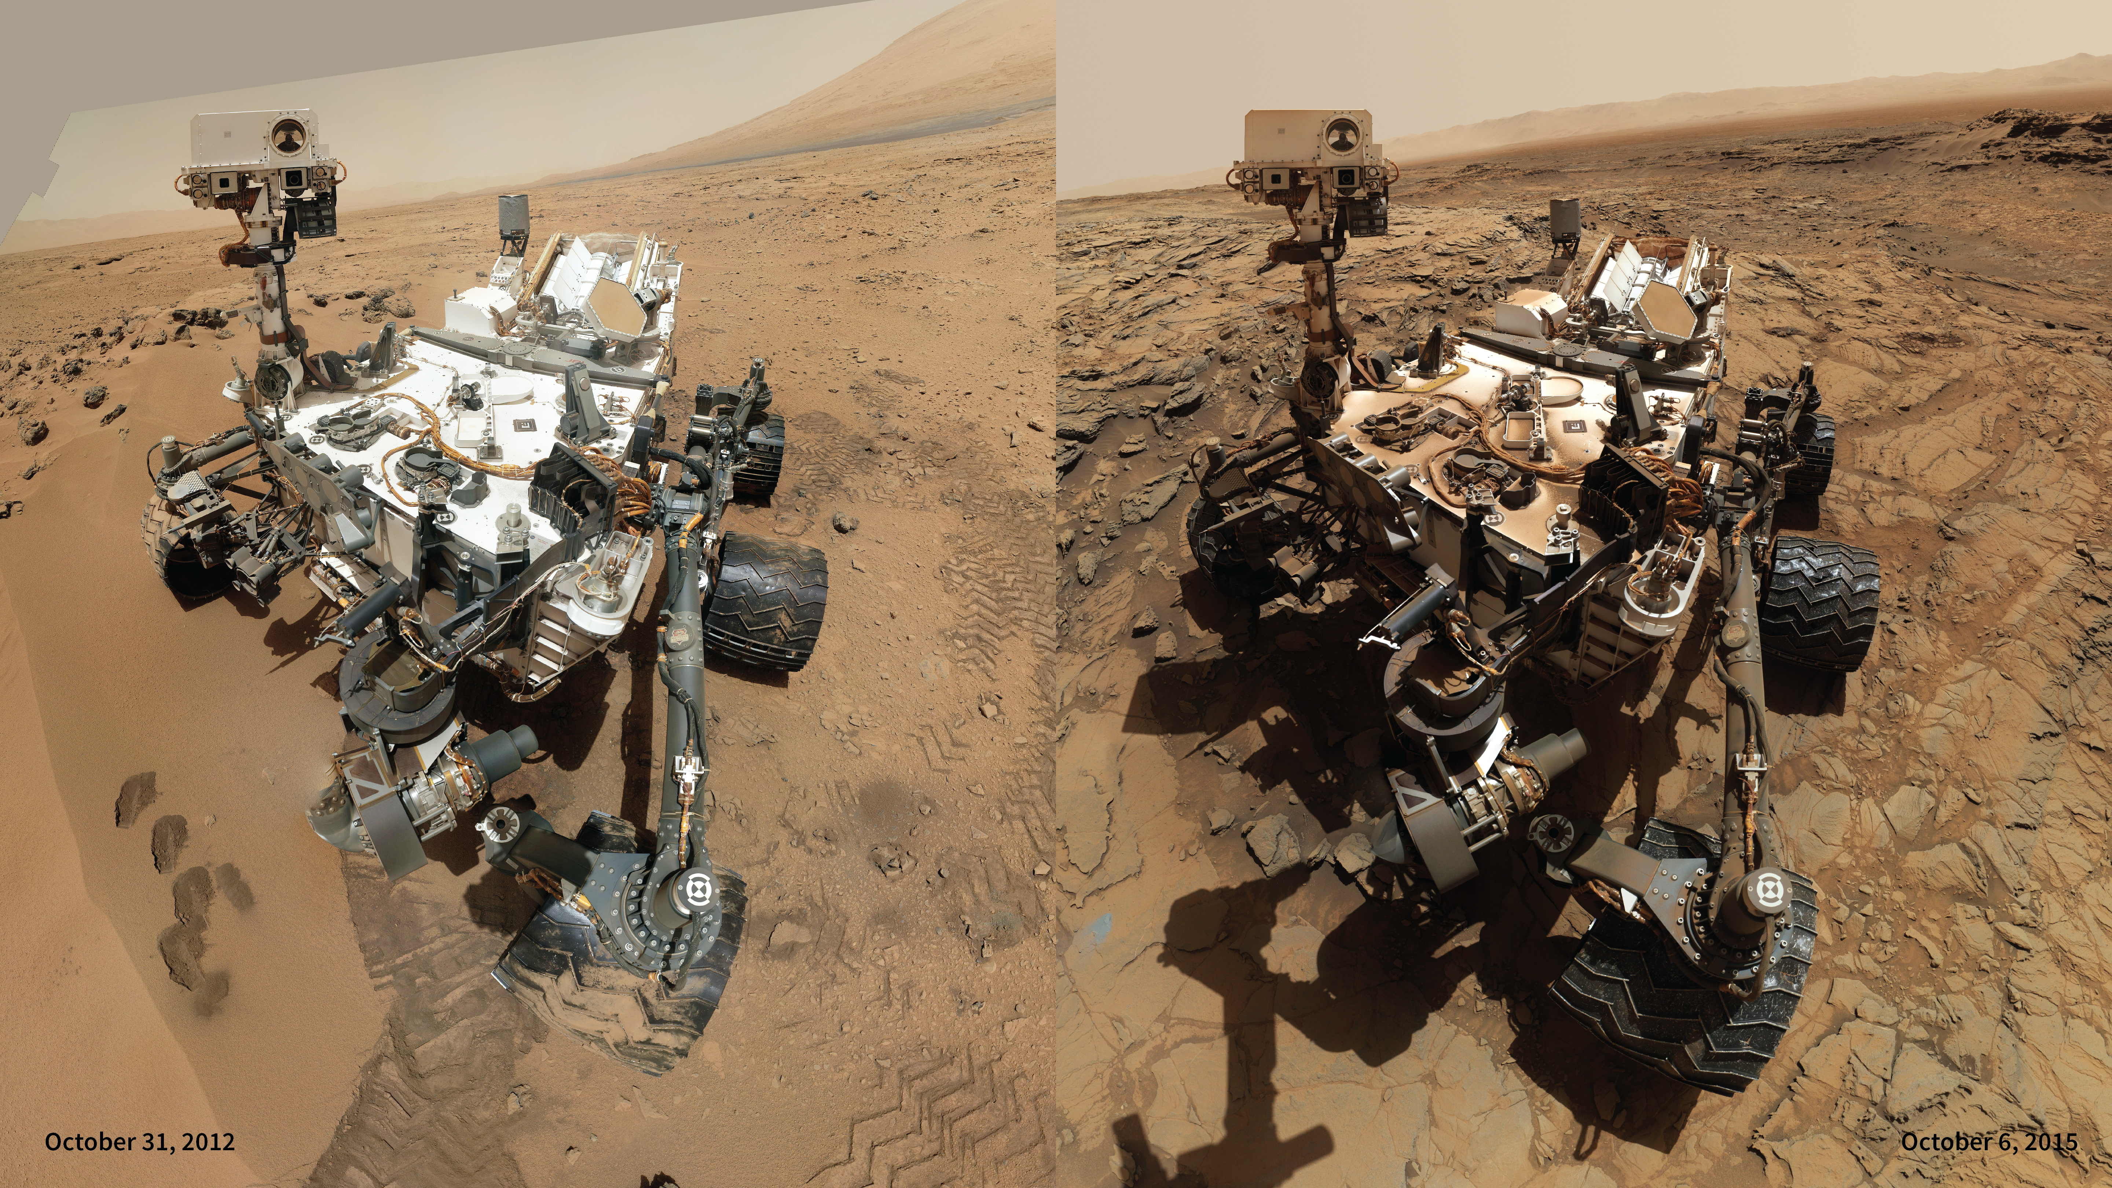
Notes:
Curiosity's Selfie Comparison
The Mars Science Laboratory’s Curiosity has the unique ability to capture self-portraits, or selfies. Curiosity uses the Mars Hand Lens Imager (MAHLI) located at the end of its robotic arm to capture sets of thumbnail images that are then stitched together to create full-color mosaics. The rover’s robotic arm is positioned out of the shot in the images, or portions of images, used to create the mosaics and therefore, is not visible.
The selfie on the left was taken on October 31, 2012, when the rover was located at "Rocknest,” the spot in Gale Crater where the mission's first scoop sampling took place. The selfie on the right was taken nearly 3 years later on October 6, 2015, when the rover was located at the "Big Sky” site, where its drill collected the mission's fifth taste of Mount Sharp. Selfies like this one document the state of the rover and allow mission engineers to track changes over time such as dust accumulation and wheel wear shown here. For scale, the rover's wheels are 20 inches (50 centimeters) in diameter and about 16 inches (40 centimeters) wide. Only MAHLI (among the rover's 17 cameras) is able to image some parts of the craft, including the portside wheels.
For more information, visit
svs.gsfc.nasa.gov/goto?30707

