Slide 1
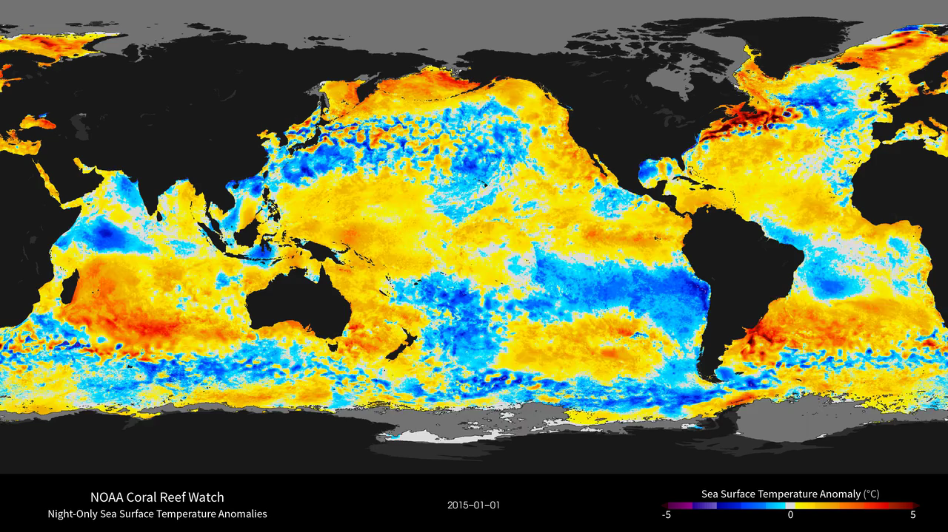
Notes:
NOAA Coral Reef Watch
The daily 5-km satellite Bleaching Alert Area (7-day maximum) product presented here outlines the areas where coral bleaching thermal stress currently reaches various bleaching stress levels, based on our satellite sea surface temperature (SST) monitoring.
For more information, see:
http://svs.gsfc.nasa.gov/goto?30728
http://coralreefwatch.noaa.gov

