Slide 1
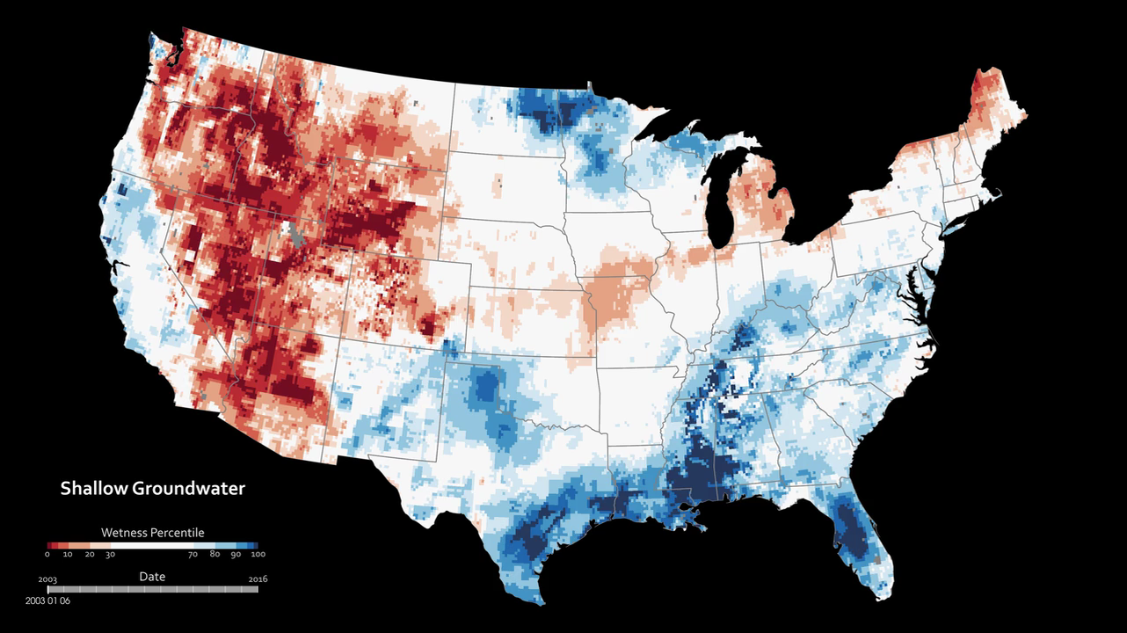
Notes:
Measuring Soil Moisture From Space
These maps combine data from the twin satellites of the Gravity Recovery and Climate Experiment (GRACE) with other satellite and ground-based measurements to model the relative amount of water stored at two different levels: at plant root level and underground.
The wetness, or water content, of each layer is compared to the average between 1948 and 2009. The darkest red regions represent dry conditions that should occur only 2 percent of the time (about once every 50 years).
All of the maps are experimental products funded by NASA’s Applied Sciences Program and developed by scientists at NASA’s Goddard Space Flight Center and the National Drought Mitigation Center. The maps do not attempt to represent human consumption of water; but rather, they show changes in water storage related to weather, climate, and seasonal patterns.
For more information:
drought.unl.edu/MonitoringTools/NASAGRACEDataAssimilation.aspx

