Slide 1
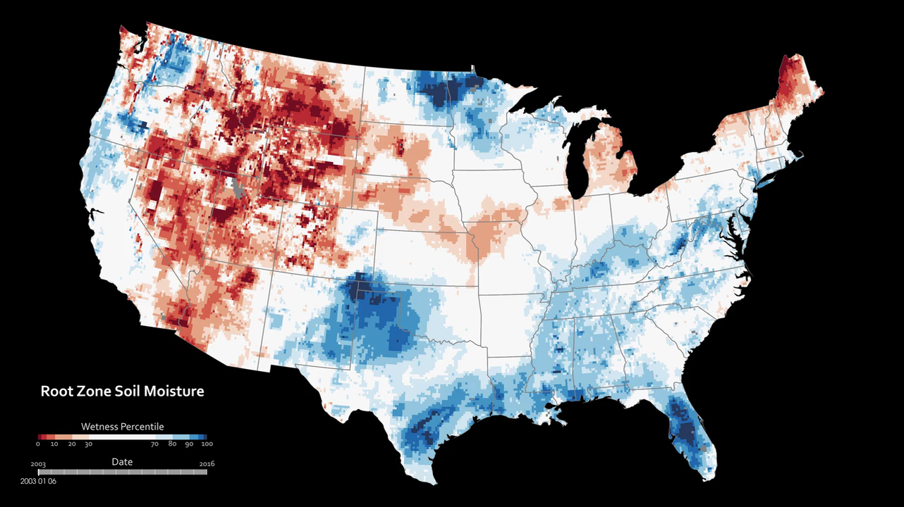
Notes:
Measuring Root-Zone Soil Moisture From Space
This map combines data from the twin satellites of the Gravity Recovery and Climate Experiment (GRACE) with other satellite and ground-based measurements to model the relative amount of water stored at plant root level (the top meter of soil).
The wetness, or water content, is compared to the average between 1948 and 2009. The darkest red regions represent dry conditions that should occur only 2 percent of the time (about once every 50 years). The map is an experimental product funded by NASA’s Applied Sciences Program and developed by scientists at NASA’s Goddard Space Flight Center and the National Drought Mitigation Center. The maps do not attempt to represent human consumption of water; but rather, they show changes in water storage related to weather, climate, and seasonal patterns.
For more information:
drought.unl.edu/MonitoringTools/NASAGRACEDataAssimilation.aspx

