Slide 1
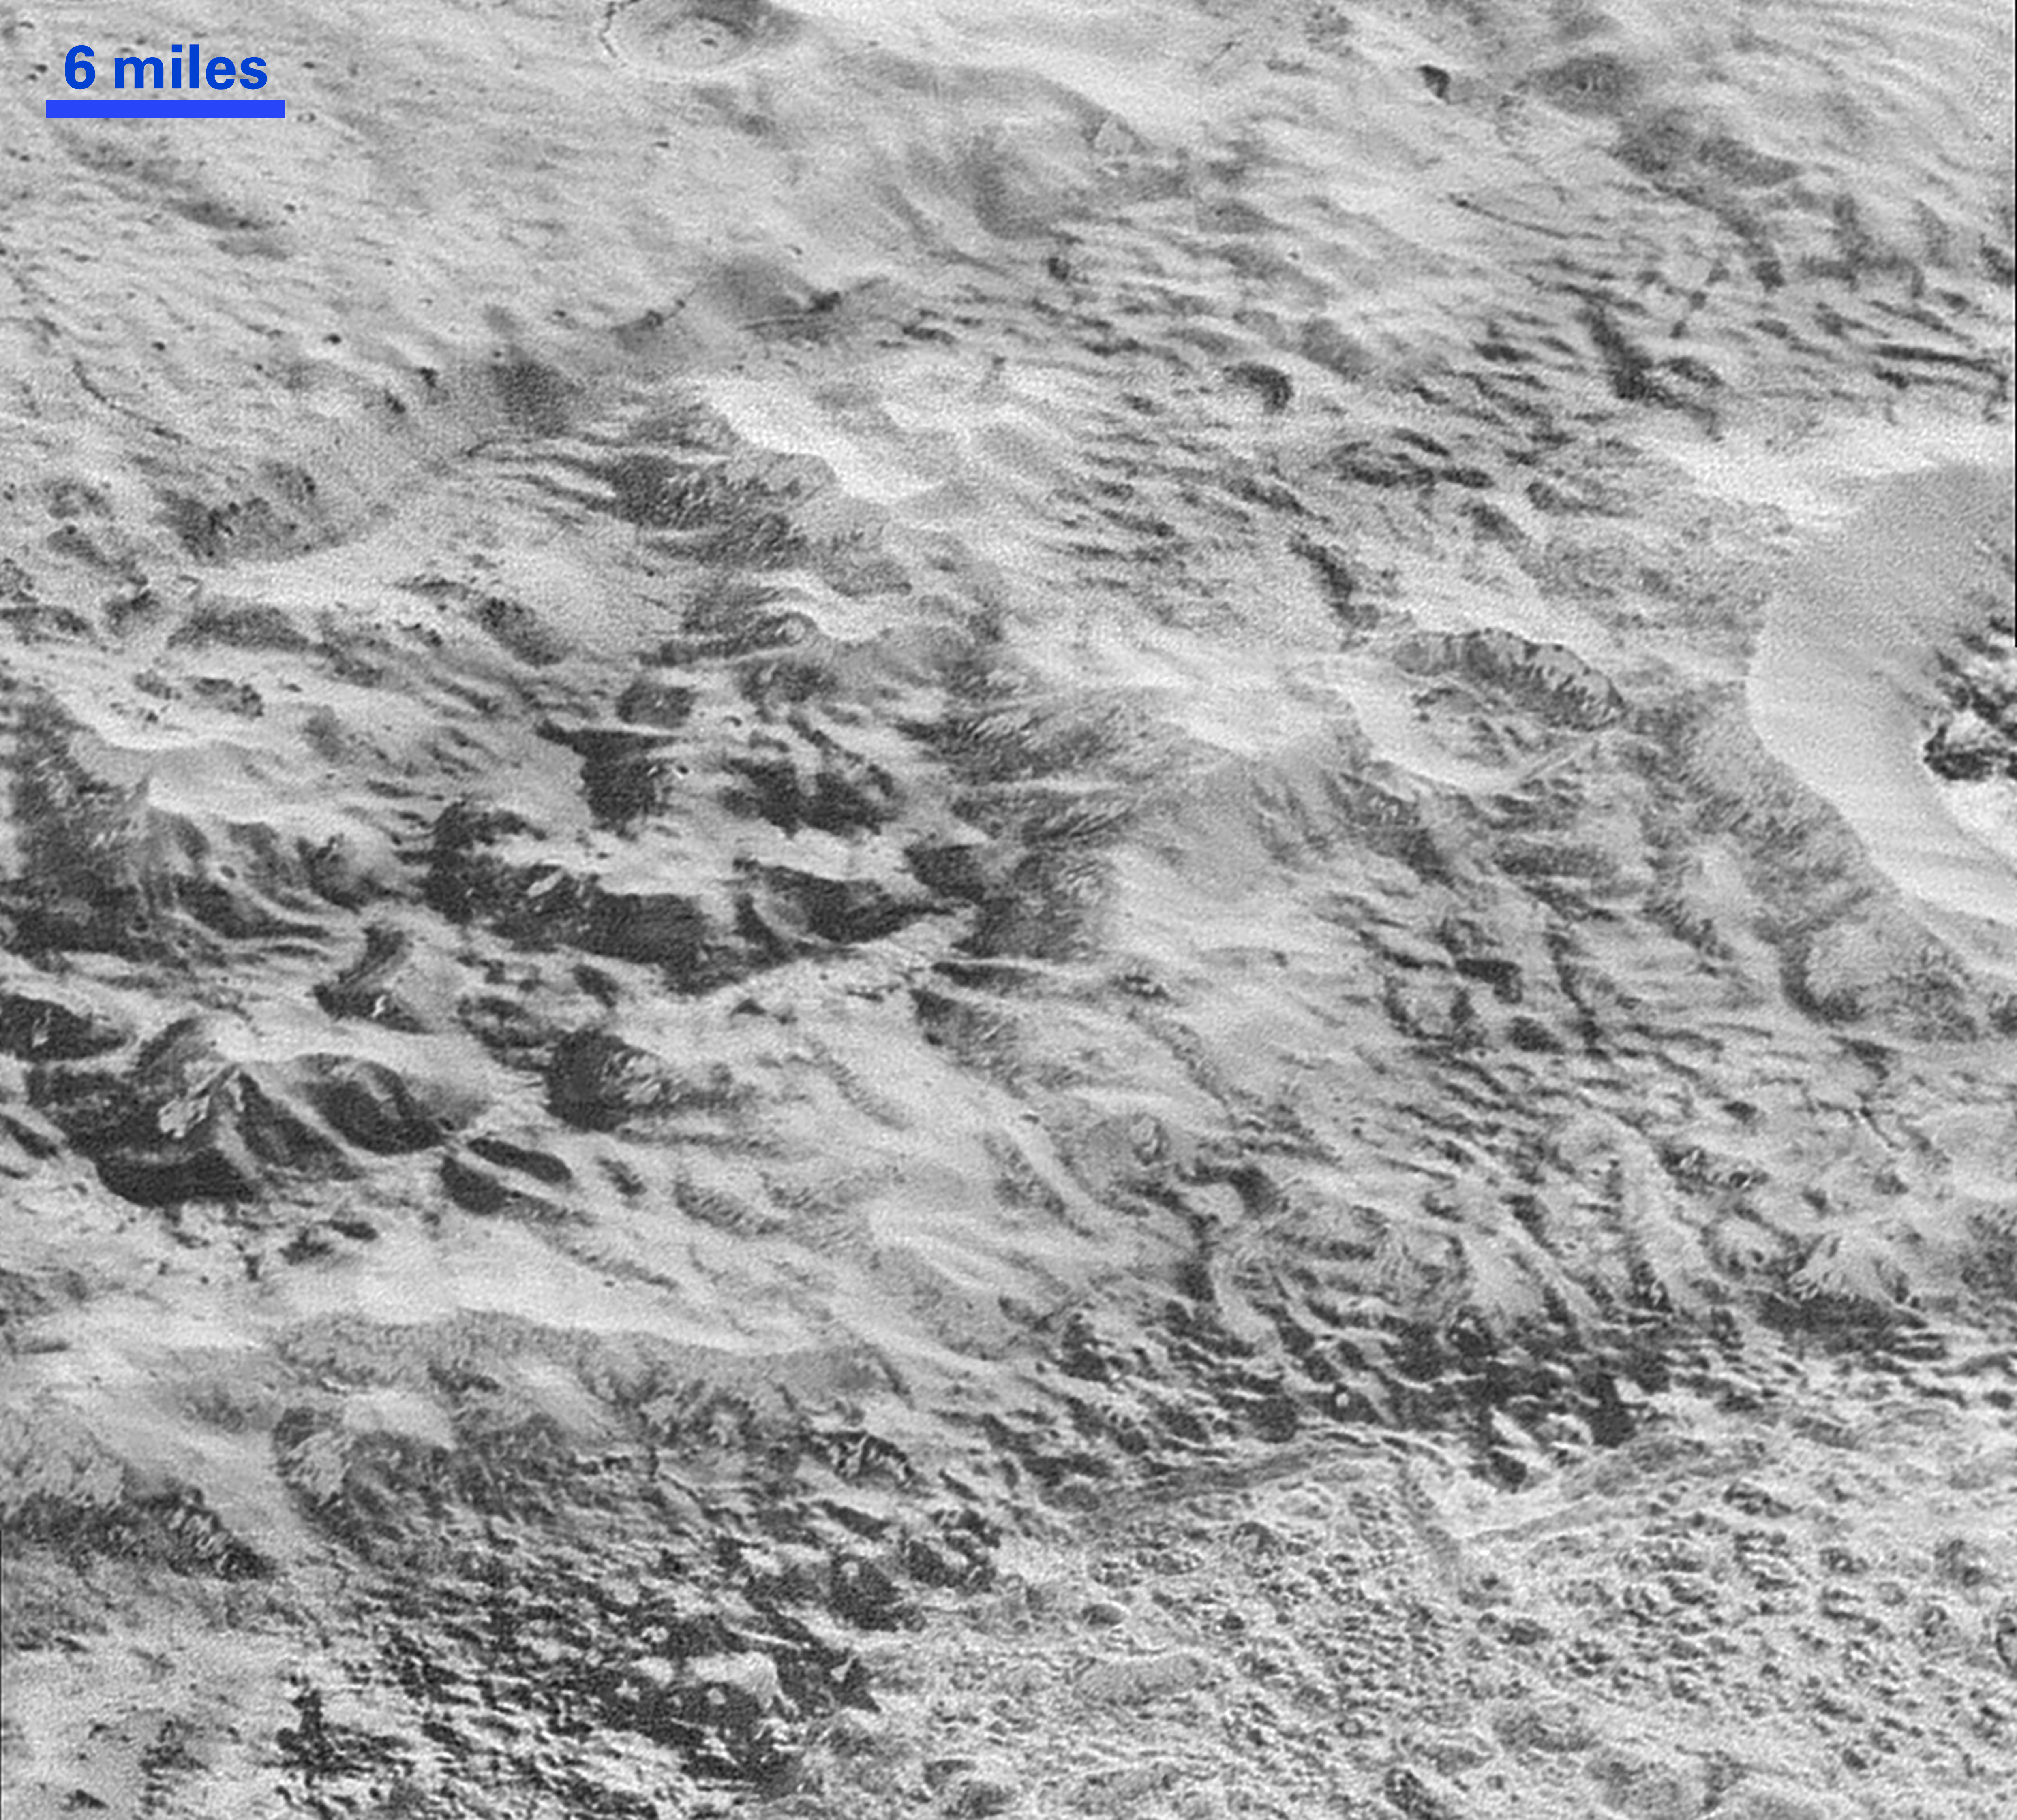
Notes:
Pluto’s 'Badlands'
This highest-resolution image from NASA’s New Horizons spacecraft shows how erosion and faulting has sculpted this portion of Pluto’s icy crust into rugged badlands. The prominent 1.2-mile-high cliff at the top, running from left to upper right, is part of a great canyon system that stretches for hundreds of miles across Pluto’s northern hemisphere. New Horizons team members think that the mountains in the middle are made of water ice, but have been modified by the movement of nitrogen or other exotic ice glaciers over long periods of time, resulting in a muted landscape of rounded peaks and intervening sets of short ridges. At the bottom of this 50-mile-wide image, the terrain transforms dramatically into a fractured and finely broken up floor at the northwest margin of the giant ice plain informally called Sputnik Planum. The top of the image is to Pluto’s northwest.
https://svs.gsfc.nasa.gov/cgi-bin/details.cgi?aid=30737

