Slide 1
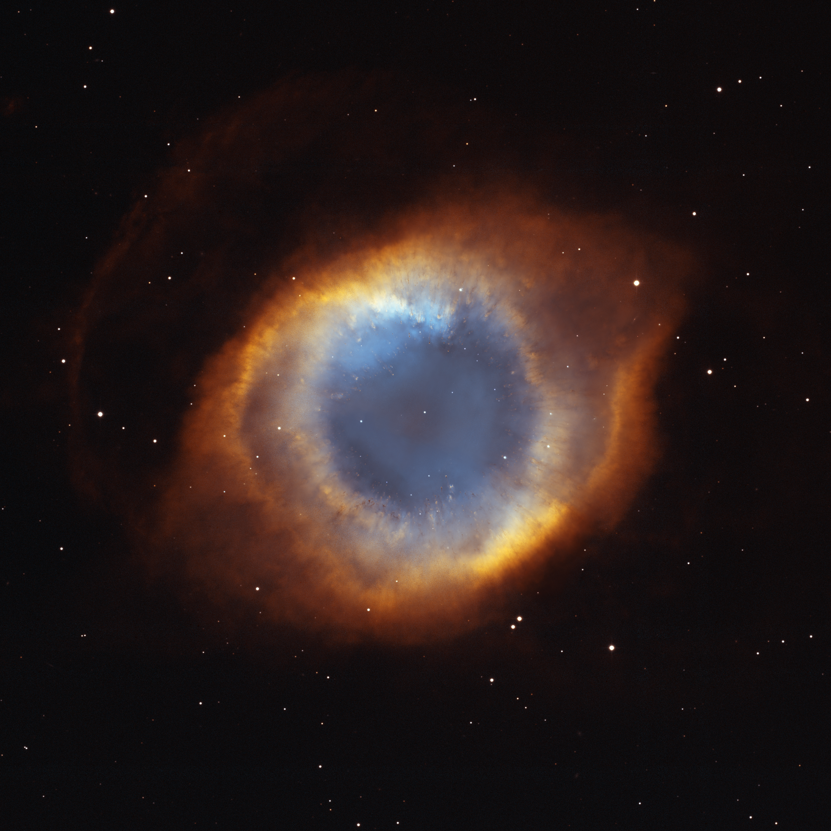
Notes:
Iridescent Glory of the Helix Nebula
This Hubble Space Telescope image showcases the details of the Helix Nebula, one of the nearest planetary nebulae to Earth. A planetary nebula forms when a medium-sized star undergoes the final stages of nuclear fusion in its core and casts of its outer layers of gas. Of particular note in the Helix is the web of filamentary "bicycle-spoke" features embedded in the colorful gas ring. The radiant colors correspond to glowing oxygen (blue) and hydrogen and nitrogen (red).

