Slide 1
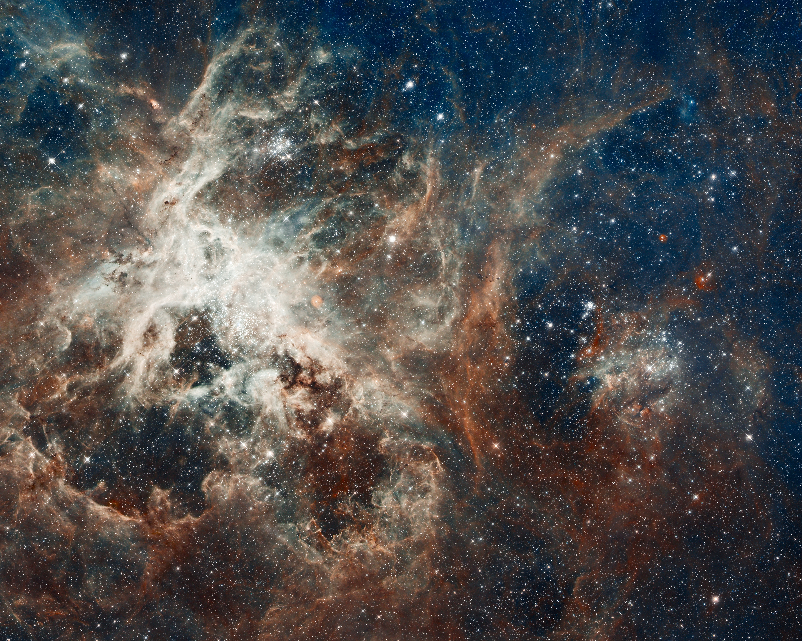
Notes:
Panoramic View of the Tarantula Nebula
Several million young stars are vying for attention in this NASA Hubble Space Telescope image of a raucous stellar breeding ground. Early astronomers gave the nebula its nickname because the glowing filaments of gas resemble spider legs. The nebula is located in the Large Magellanic Cloud, a small compainon galaxy to our Milky Way galaxy. This star-forming region is the brightest visible in a neighboring galaxy and is home to the most massive stars ever seen.

