Slide 1
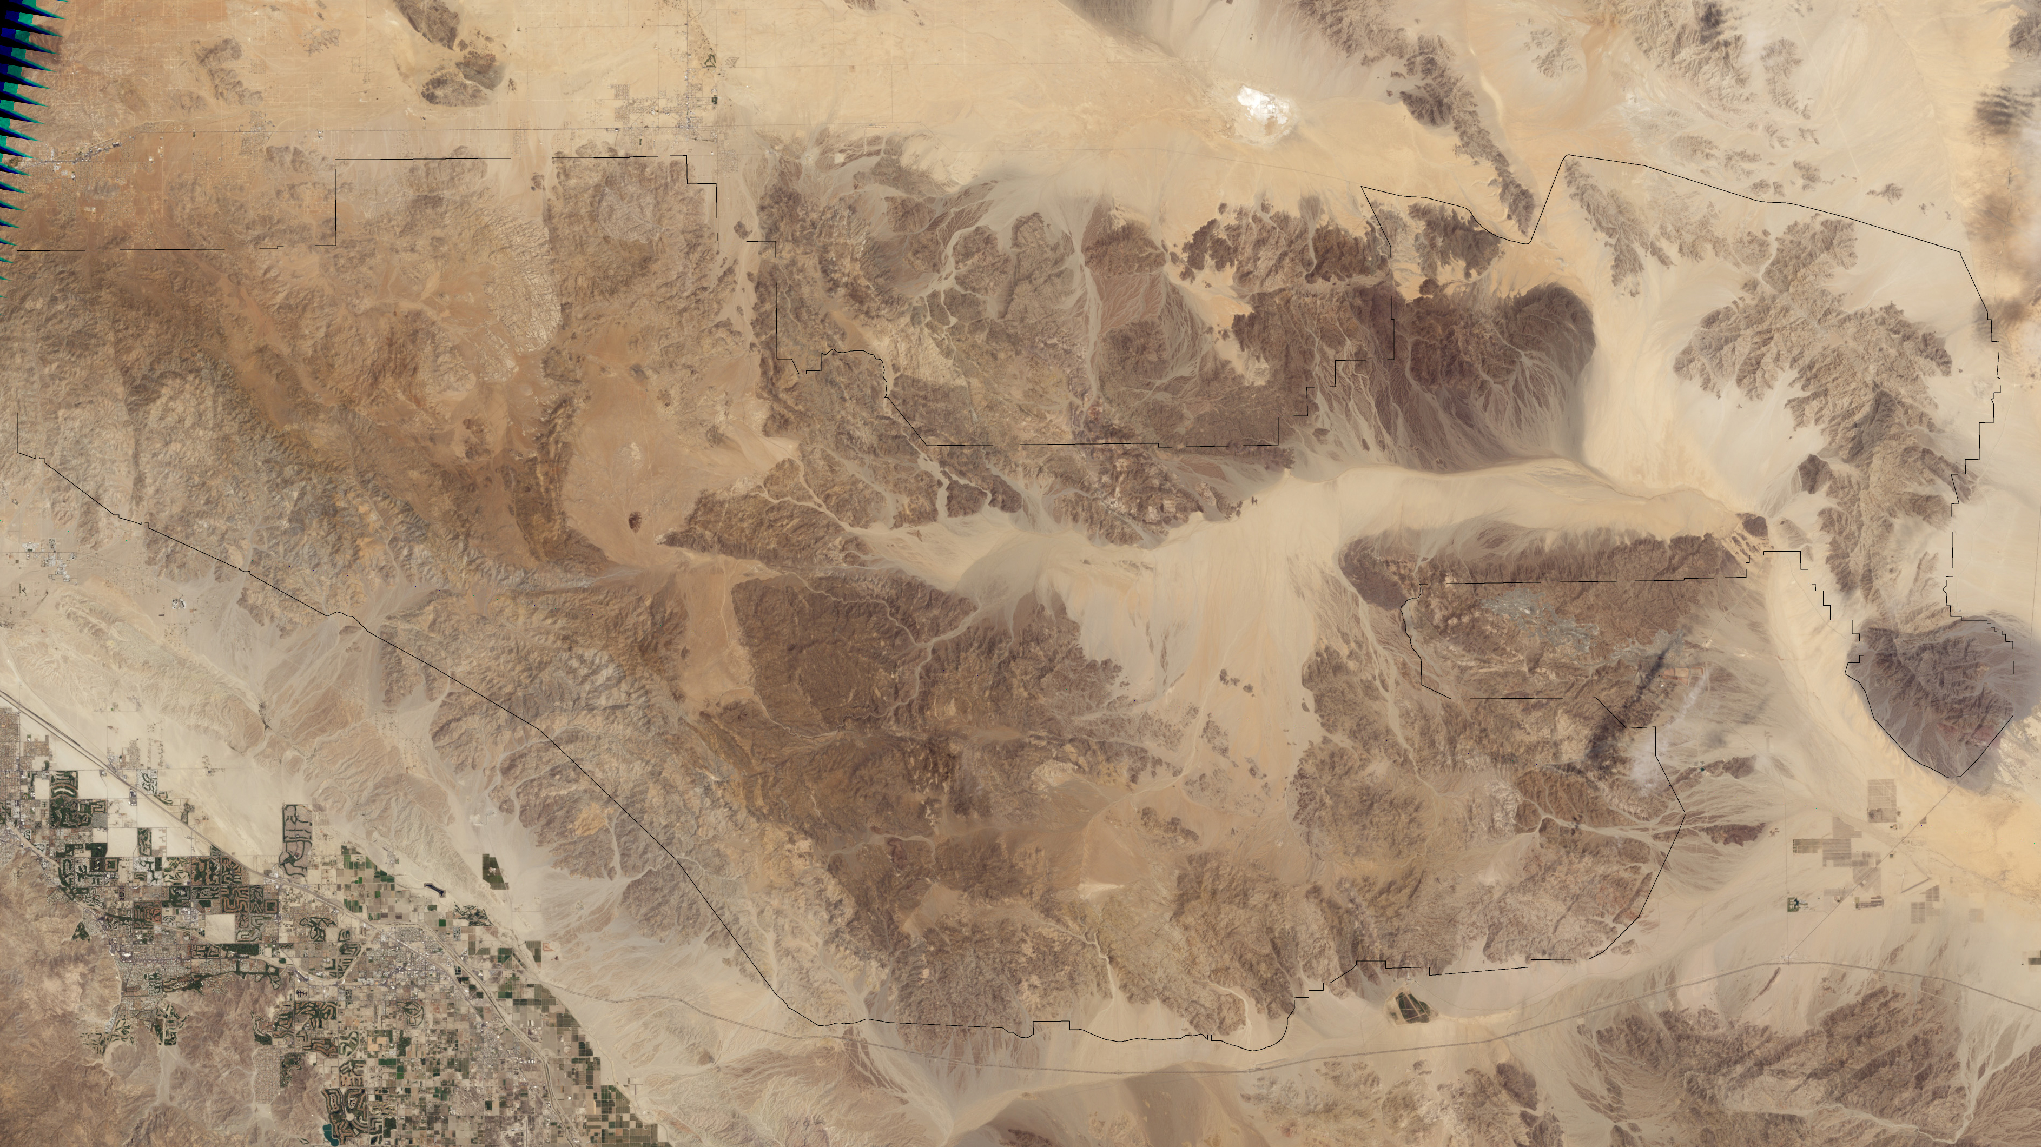
Notes:
Highlighting National Parks on the National Park Service Centennial
Joshua Tree National Park, captured by Landsat 7 ETM+ on May 28, 2003
For more information:
earthobservatory.nasa.gov/IOTD/view.php?id=36836

