Slide 1
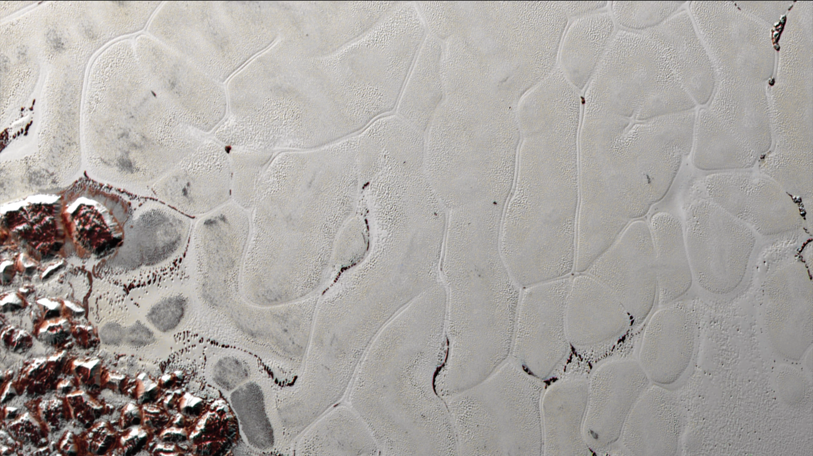
Notes:
Pluto’s Heart: A Cosmic ‘Lava Lamp’
Like a cosmic lava lamp, a large section of Pluto’s icy surface is being constantly renewed by a process called convection, replacing older surface ices with fresher material.
Combining computer models with topographic and compositional data gathered by NASA’s New Horizons spacecraft in summer 2015, New Horizons team members have determined the depth of this layer of solid nitrogen ice within Pluto's distinctive "heart" feature—a large plain informally known as Sputnik Planitia (informal name)—and how fast that ice is flowing.
The New Horizons science team used state-of-the-art computer simulations to show that the surface of Sputnik Planitia is covered with icy, churning, convective "cells" 10 to 30 miles (16 to 48 kilometers) across, and less than one million years old. The team believes the pattern of these cells stems from the slow thermal convection of the nitrogen-dominated ices that fill Sputnik Planitia. A reservoir that’s likely several miles deep in some places, the solid nitrogen is warmed by Pluto’s modest internal heat, becomes buoyant and rises up in great blobs—like a lava lamp—before cooling off and sinking again to renew the cycle. The findings offer additional insight into the unusual and highly active geology on Pluto and, perhaps, other bodies like it on the outskirts of the solar system.
For more information, visit:
http://www.nasa.gov/feature/pluto-s-heart-like-a-cosmic-lava-lamp

