Slide 1
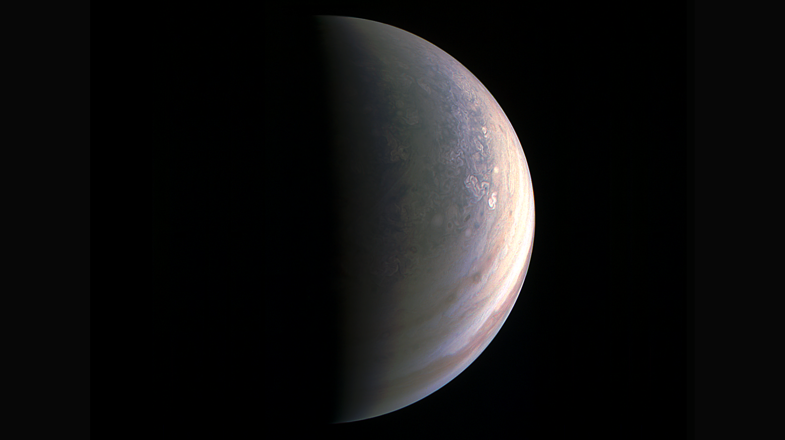
Notes:
Jupiter’s North Pole Unlike Anything Encountered in Our Solar System
NASA’s Juno spacecraft has sent back the first-ever images of Jupiter’s north pole, taken during the spacecraft’s first flyby of the planet with its instruments switched on. The images show storm systems and weather activity unlike anything previously seen on any of our solar system’s gas-giant planets. One of the most notable findings of these first-ever images of Jupiter’s north and south poles is something that the JunoCam imager did not see. Unlike Saturn, which has a persistent hexagonal feature at the north pole, there is nothing on Jupiter that anywhere near resembles that.
Juno successfully executed the first of 36 orbital flybys on August 27, 2016, when the spacecraft came about 2,500 miles (4,200 kilometers) above Jupiter’s swirling clouds. The download of six megabytes of data collected during the six-hour transit, from above Jupiter’s north pole to above its south pole, took one-and-a-half days. While analysis of this first data collection is ongoing, some unique discoveries have already been made. First glimpse of Jupiter’s north pole shows it to be bluer in color than other parts of the planet, and there are a lot of storms. The image here is one example illustrating how the largest planet in our solar system is truly unique.
For more information, visit:
http://www.nasa.gov/feature/jpl/jupiter-s-north-pole-unlike-anything-encountered-in-solar-system

