Slide 1
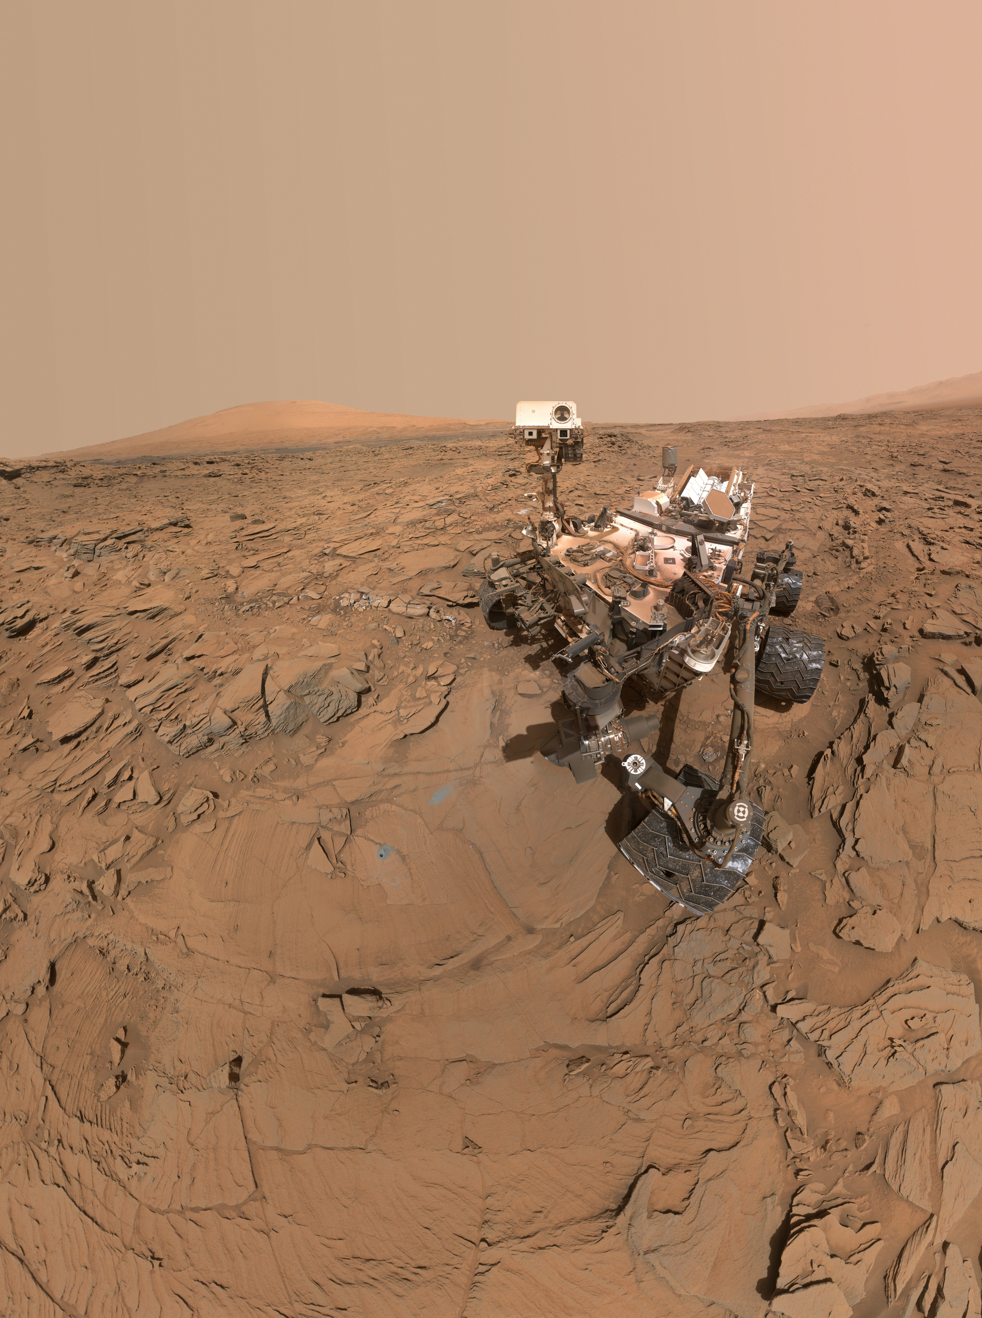
Notes:
Curiosity Self-Portrait at 'Okoruso' Drill Hole
This self-portrait of NASA's Curiosity Mars rover shows the vehicle at a drilled sample site called "Okoruso," on the "Naukluft Plateau" of lower Mount Sharp. The scene combines multiple images taken with the rover's Mars Hand Lens Imager (MAHLI) on May 11, 2016, during the 1,338th Martian day, or sol, of the rover's work on Mars.
In front of the rover is the hole, surrounded by grayish drill cuttings, created by using Curiosity's drill to collect sample rock powder at Okoruo, plus a patch of powder dumped onto the ground after delivery of a portion to the rover's internal Chemistry and Mineralogy (CheMin) laboratory instrument.
The rover team compared the rock powder from drilling at Okoruso to material from the nearby "Lubango" drilling site, which is visible behind the rover, just to the left of the mast. The Lubango site was selected within a pale zone, or "halo," beside a fracture in the area's sandstone bedrock. Okoruso is in less-altered bedrock farther from any fractures. Note that the Okoruso drill cuttings appear darker than the Lubango drill cuttings. The Lubango sample was found to be enriched in silica and sulfates, relative to Okoruso.
For more information, visit:
http://www.jpl.nasa.gov/spaceimages/details.php?id=PIA20602

