Slide 1
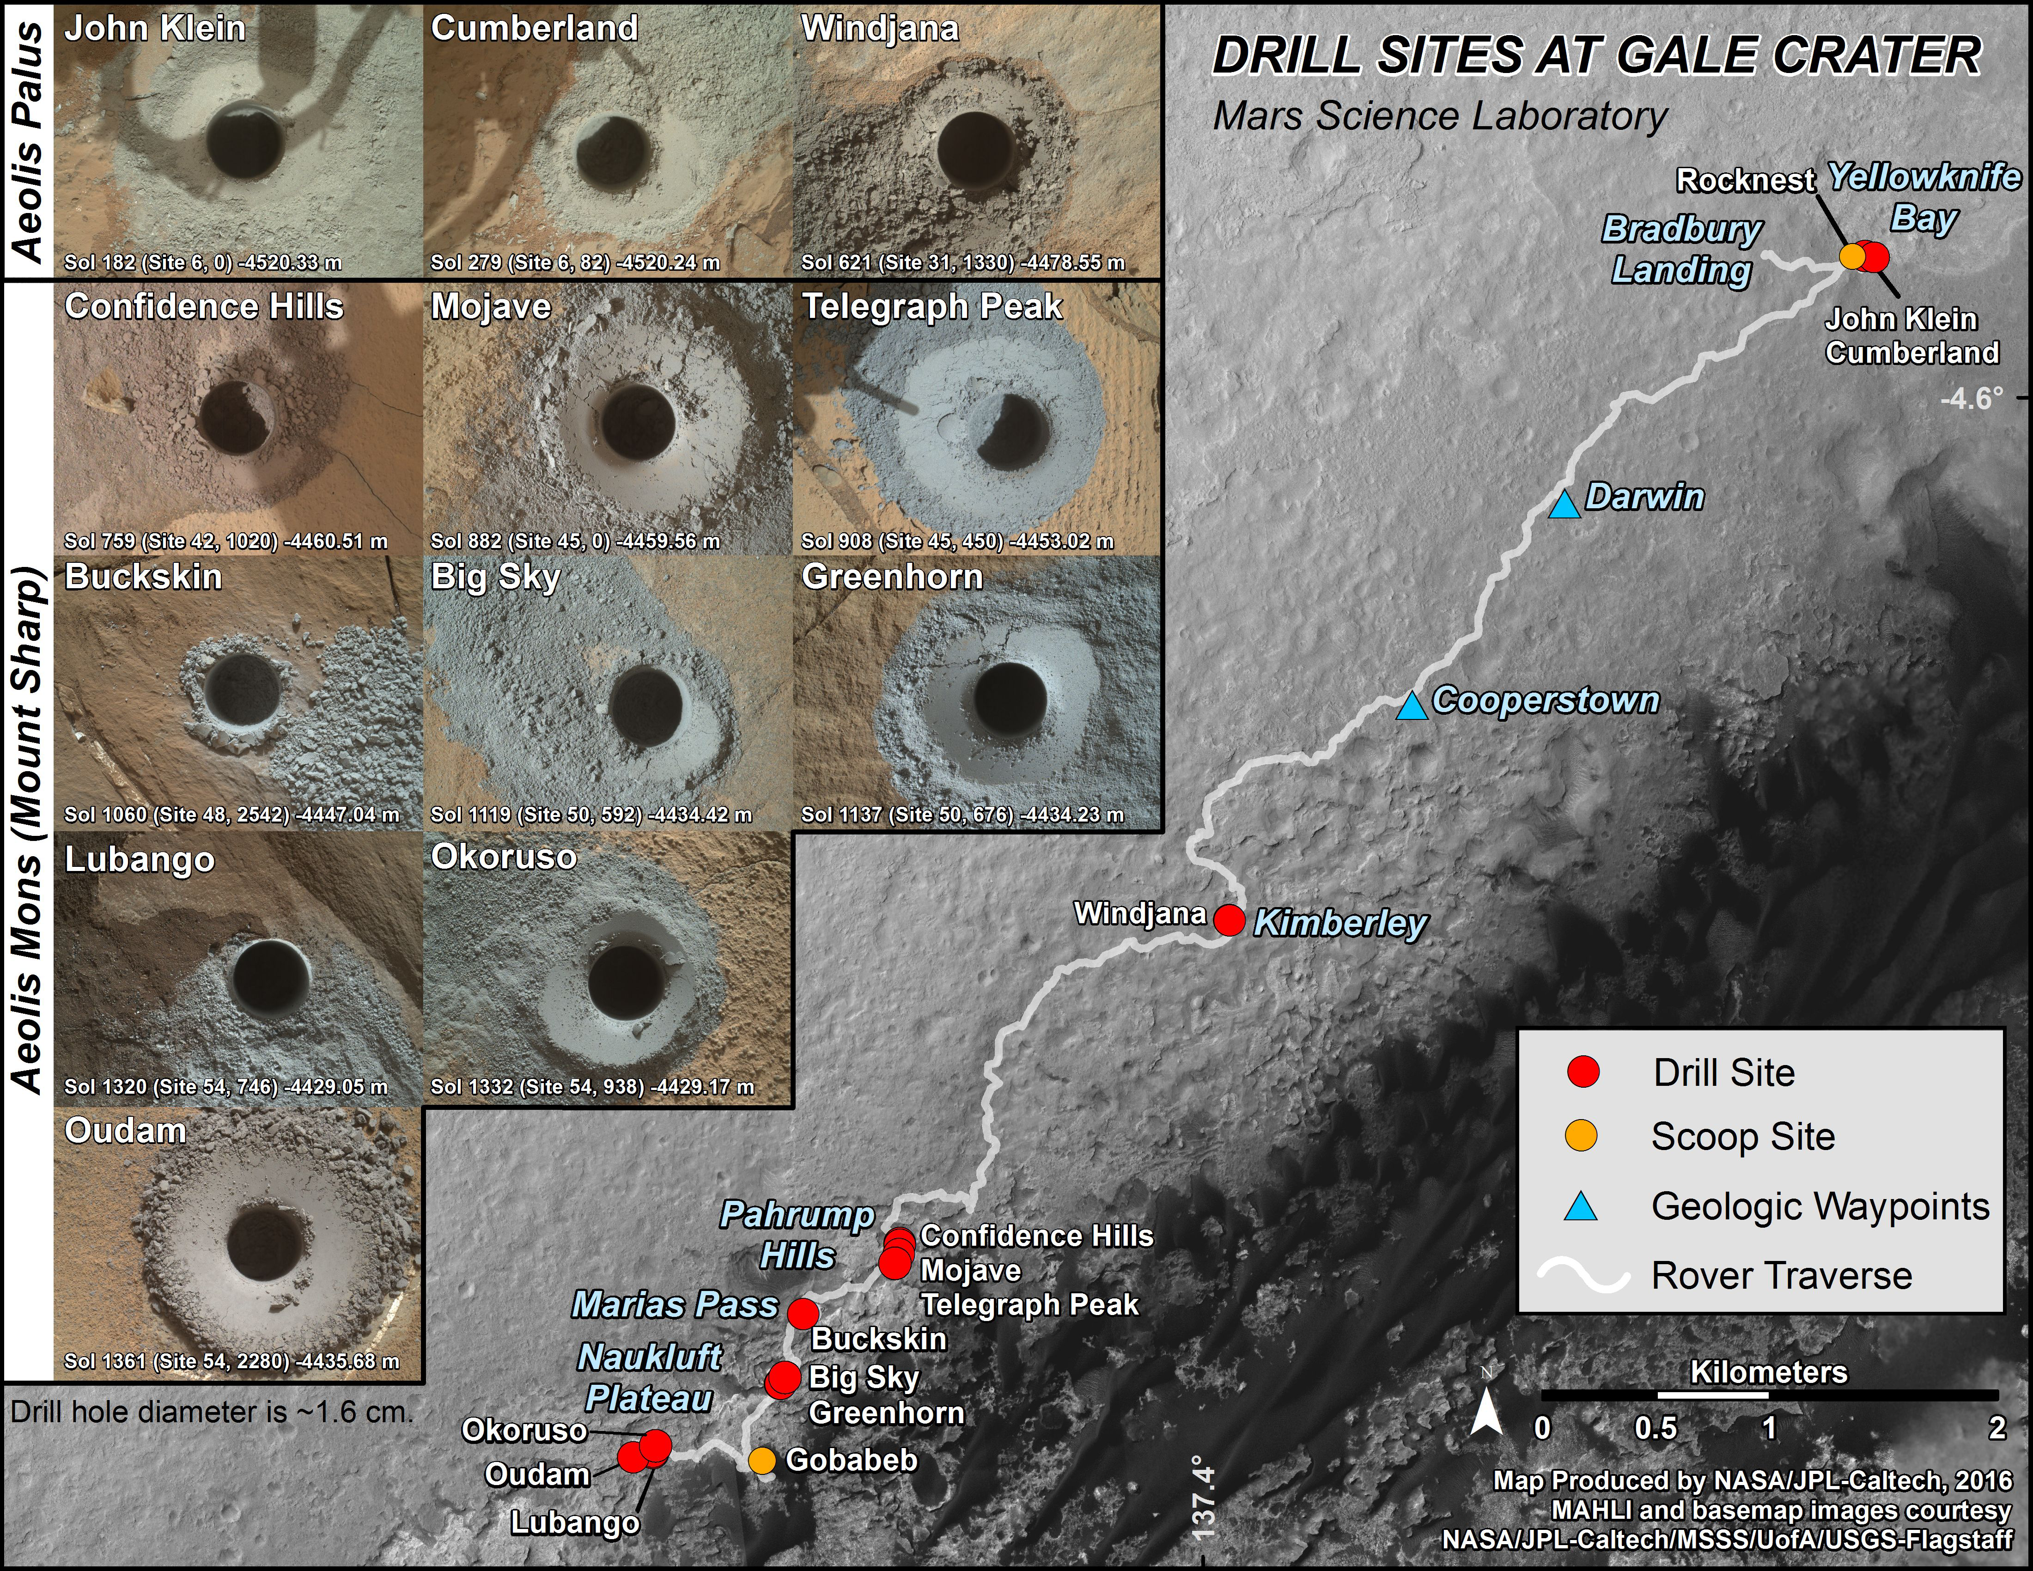
Notes:
Curiosity's First 14 Rock or Soil Sampling Sites on Mars
This graphic maps locations of the first 14 sites where NASA's Curiosity Mars rover collected rock or soil samples for analysis by laboratory instruments inside the vehicle. It also presents images of the drilled holes where 12 rock-powder samples were acquired. At the other two sites -- Rocknest and Gobabeb -- Curiosity scooped soil samples.
The diameter of each drill hole is about 0.6 inch (1.6 centimeters), slightly smaller than a U.S. dime. The images used here are raw color, as recorded by the rover's Mars Hand Lens Imager (MAHLI) camera. Notice the differences in color of the material at different drilling sites.
The latest sample site included is "Oudam," where Curiosity drilled into mudstone of the "Murray formation" on June 4, during the 1,361th Martian day, or sol, of the mission.
Curiosity landed in August 2012 on the plain (named Aeolis Palus) near Mount Sharp (or Aeolis Mons).
Dates when the first 11 drilled-rock samples were collected are: "John Klein" on Feb. 8, 2013 (Sol 182); "Cumberland" on May 19, 2013 (Sol 279); "Windjana" on May 5, 2014 (Sol 621); "Confidence Hills" on Sept. 24, 2014 (Sol 759); "Mojave" on Jan. 29, 2015 (Sol 882); "Telegraph Peak" on Feb. 24, 2015 (Sol 908); "Buckskin" on July 30, 2015 (Sol 1060); "Big Sky" on Sept. 29, 2015 (Sol 1119); "Greenhorn" on Oct. 18, 2015 (Sol 1137); "Lubango" on April 23, 2016 (Sol 1320); and "Okoruso" on May 5, 2016 (Sol 1332).
For more information, visit:
http://photojournal.jpl.nasa.gov/catalog/PIA20748

