Slide 1
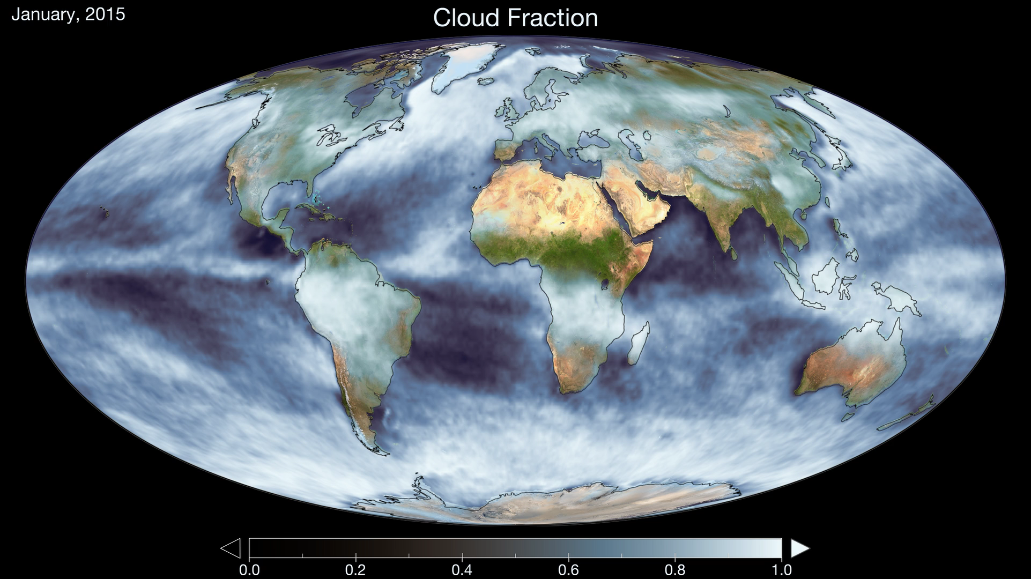
Notes:
How cloudy is Earth?
MODIS aboard Aqua with its wide coverage can tell us how cloudy different parts of the world are. This animation shows how cloud amount varies within a year throughout the globe.
For more information, visit:
svs.gsfc.nasa.gov/30839

