Slide 1
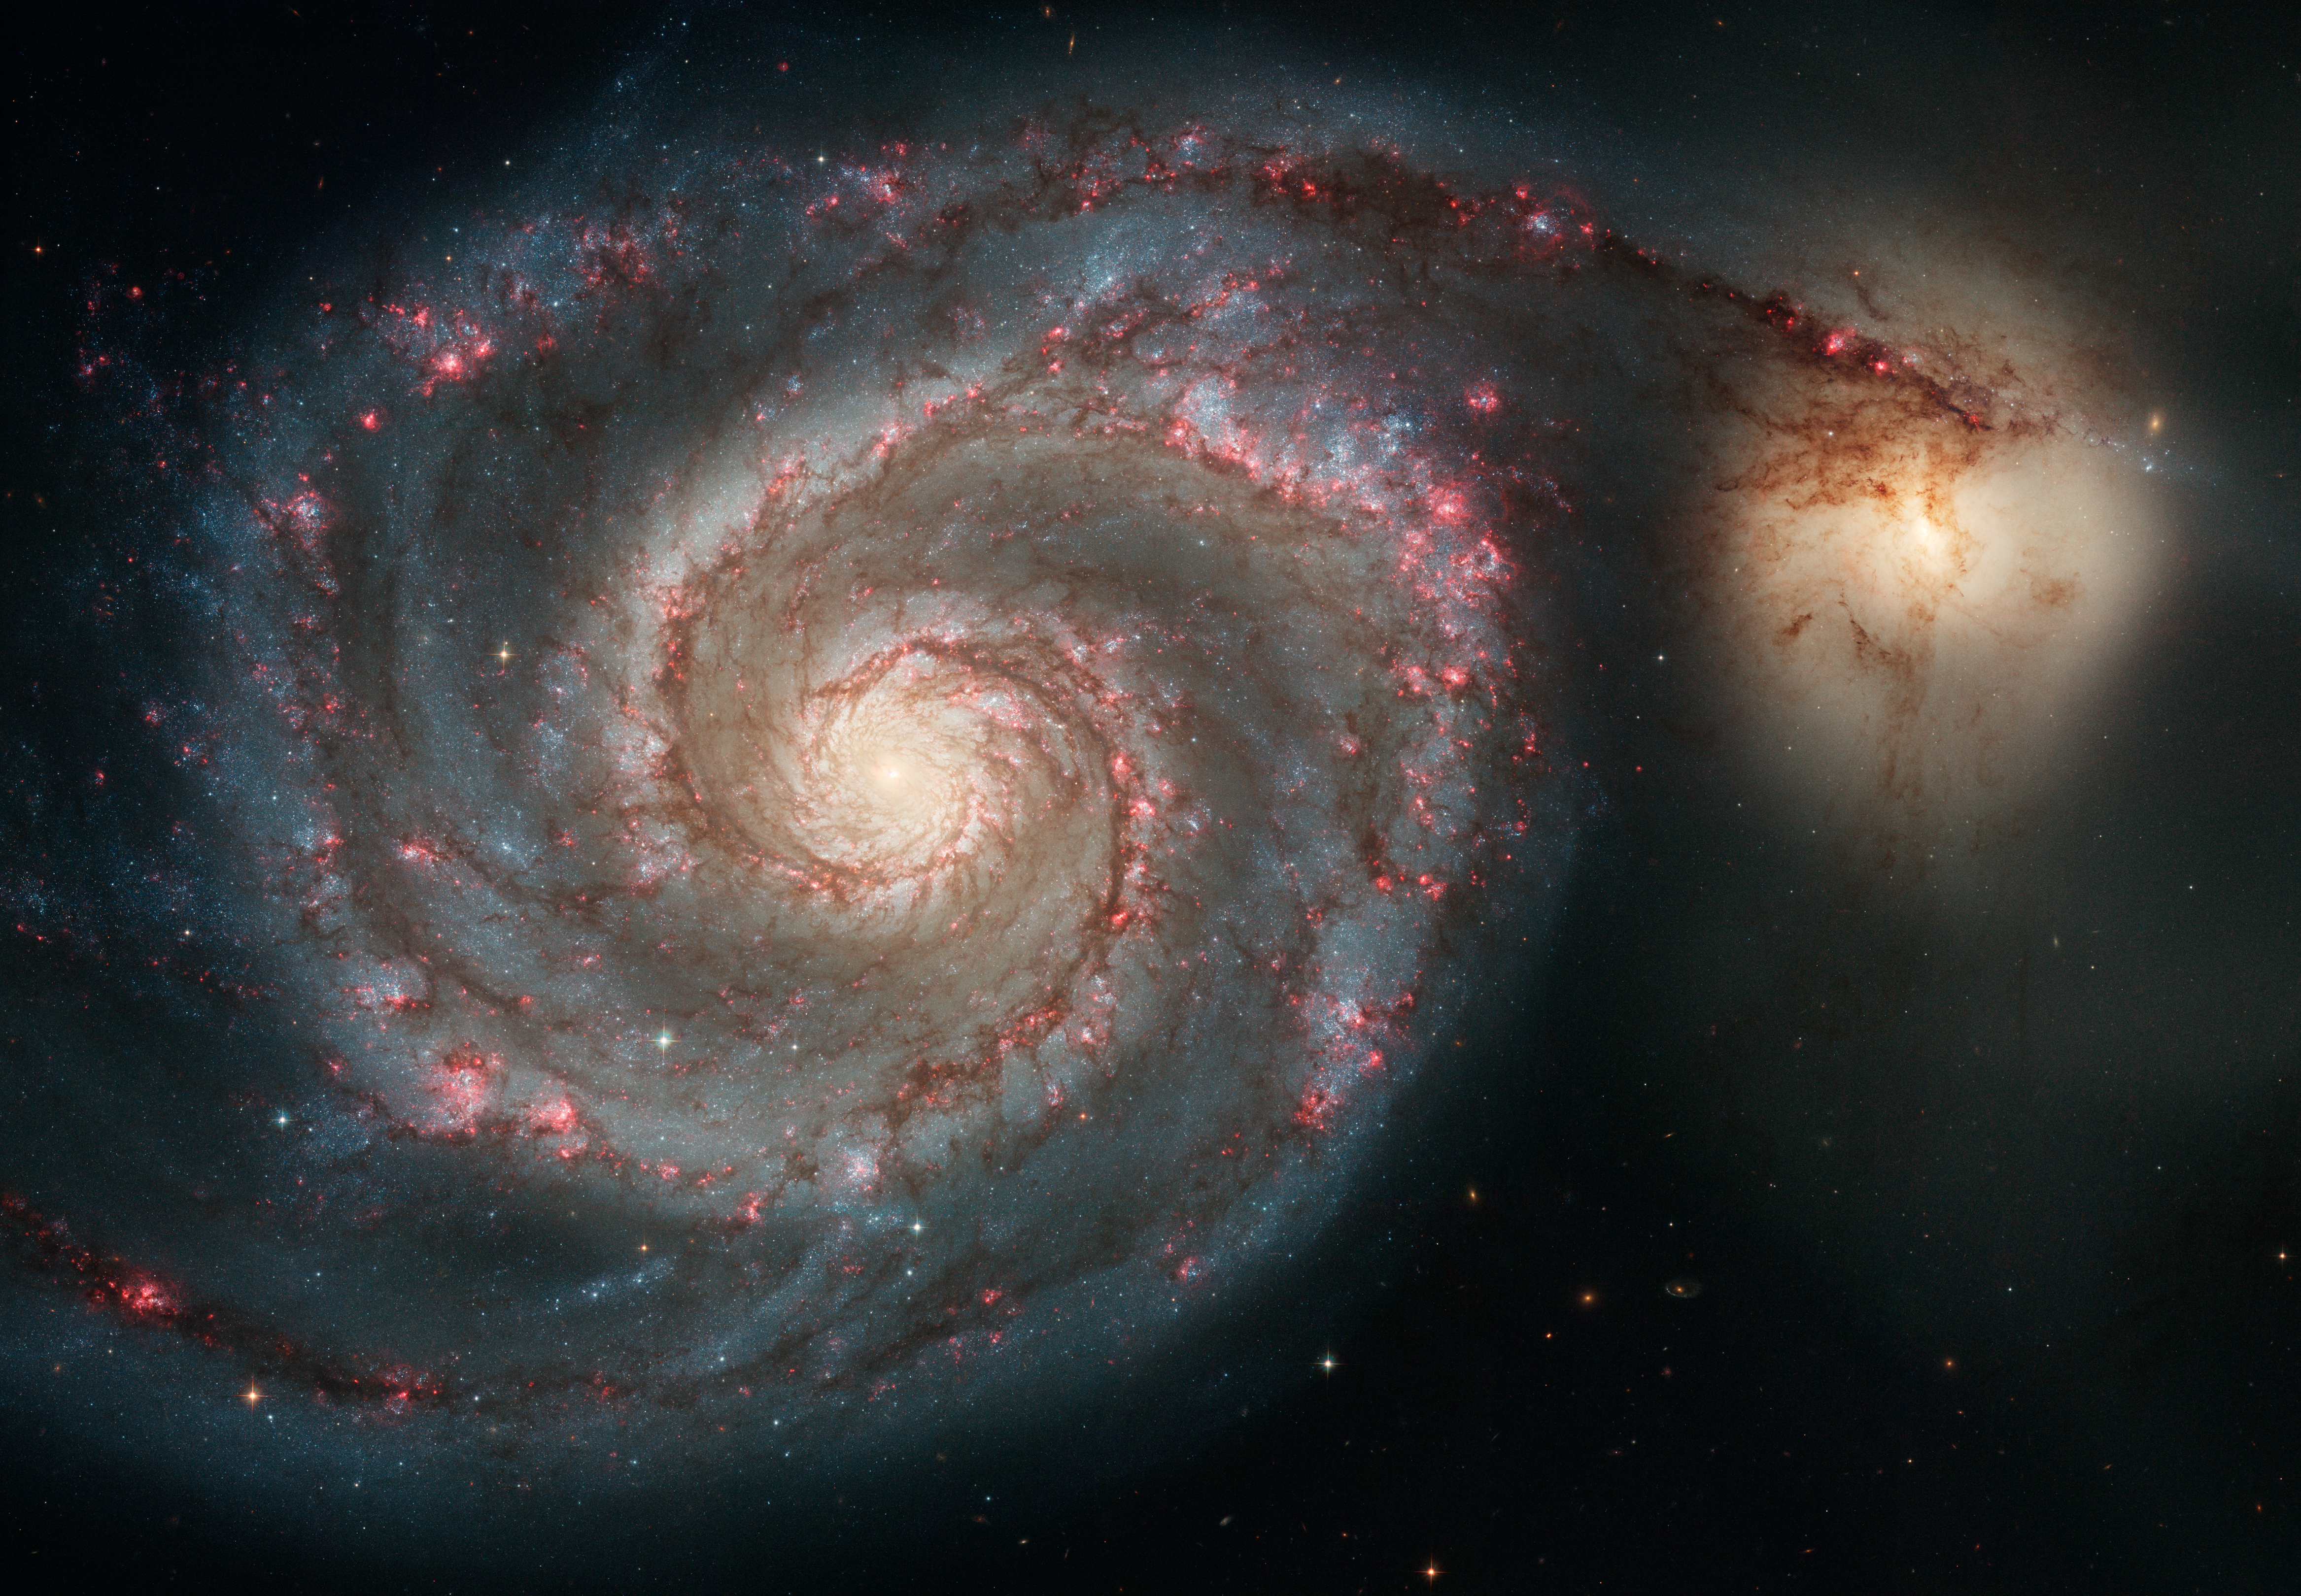
Notes:
The Whirlpool Galaxy
This Hubble Space Telescope image provides a strikingly detailed view of the grand design spiral galaxy and its companion galaxy. The face-on view exposes the structure of the galaxy's pancake-shaped disk, from its curving spiral arms, where young stars reside, to its yellowish central core, a home to older stars. The spiral arms are star-formation factories, where density waves compress dark gas clouds, stars form in glowing pink nebulae, and bright blue star clusters are the end product.

