Slide 1
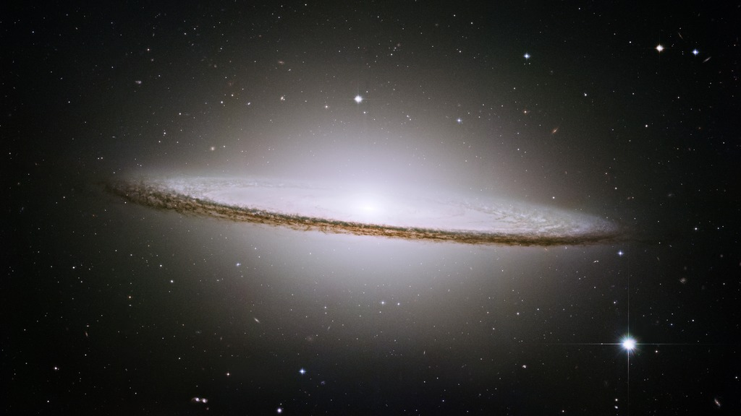
Notes:
Sombrero Galaxy
NASA's Hubble Space Telescope has trained its razor-sharp eye on one of the universe's most stately and photogenic galaxies. The galaxy's hallmark is a brilliant white, bulbous core encircled by the thick dust lanes comprising the spiral structure of the galaxy. This brilliant galaxy was named the Sombrero because of its resemblance to the broad rim and high-topped Mexican hat. Six pointings were needed to cover this magnificent galaxy whose apparent diameter is nearly one-fifth the diameter of the full moon. Images were taken in three filters (red, green, and blue) to yield a natural-color image.

