Slide 1
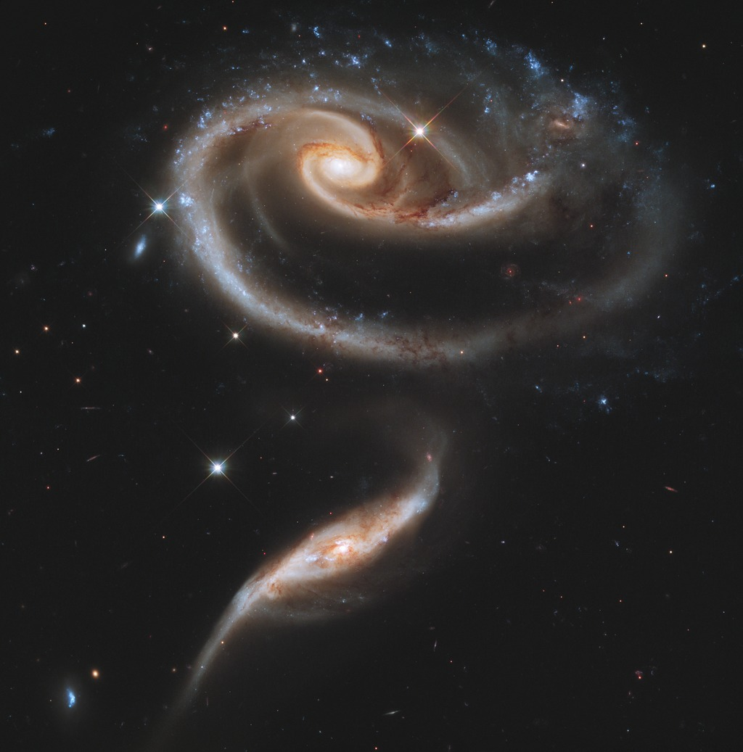
Notes:
Interacting Galaxy Pair Arp 273
The NASA Hubble Space Telescope turned its keen eye to an especially photogenic group of interacting galaxies. The larger of the spiral galaxies has a disk that is tidally distorted into a rose-like shape by the gravitational tidal pull of the companion galaxy. A swath of blue jewels across the top is the combined light from clusters of intensely bright and hot young blue stars. The smaller, nearly edge-on companion shows distinct signs of intense star formation at its nucleus, perhaps triggered by the encounter with the larger galaxy.

