Slide 1
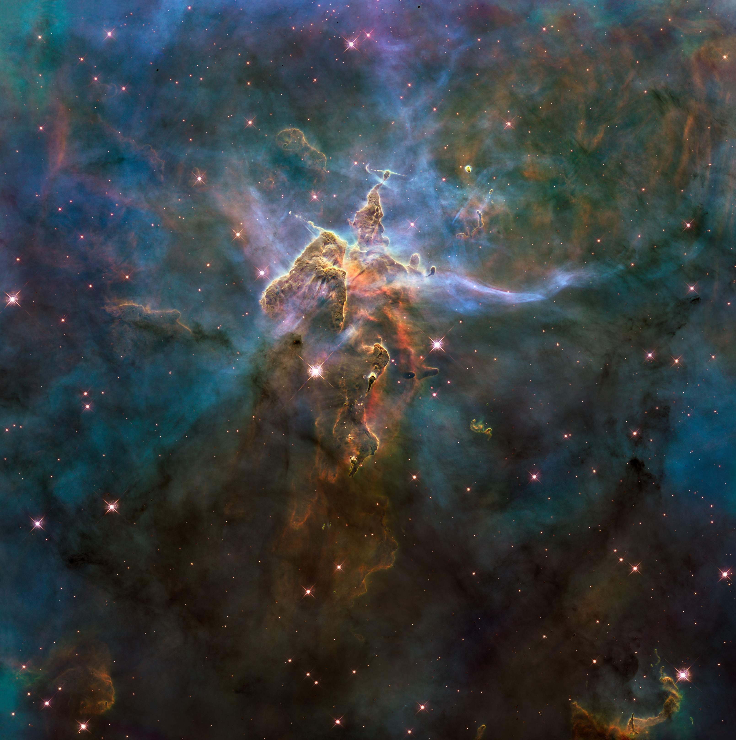
Notes:
Mystic Mountain
This craggy mountaintop enshrouded by wispy clouds looks like a fantasy landscape from imaginative fiction. However, this NASA Hubble Space Telescope photograph exemplifies the adage that truth is stranger than fiction.
The image captures the chaotic activity atop a three-light-year-tall pillar of gas and dust that is being eaten away by the brilliant light from nearby bright stars. The pillar is also being assaulted from within, as infant stars buried inside it fire off jets of gas that can be seen streaming from towering peaks.

