Slide 1
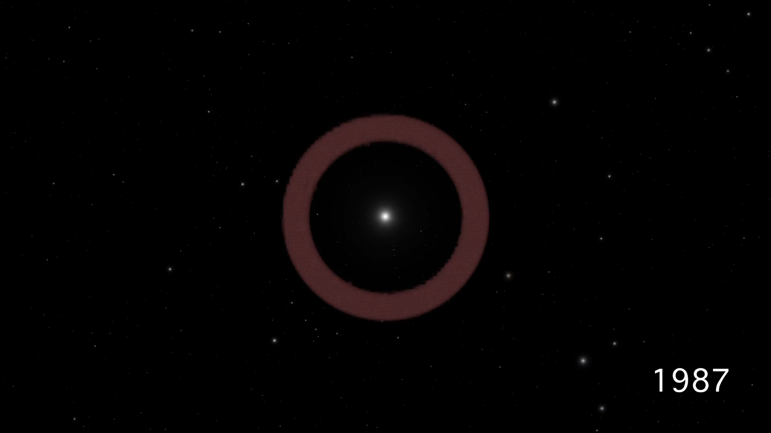
Notes:
Blast Wave from Supernova 1987A
This scientific visualization shows the development of Supernova 1987A, from the initial blast observed three decades ago to the luminous ring of material we see today.
The sequence, using data from a computer simulation, begins with the star before it exploded. A ring of material around the star was expelled about 20,000 years before the supernova outburst. A flash of light signals the later stellar explosion. The supernova sends a blast wave outward from the dying star. As the blast wave slams into the ring, high-density knots of material become intensely heated and glow brightly, while lower-density gas is blown outward. The computer simulation provides one data set per year, and thus the visualization steps between them at four years per second. Upon reaching the present day, the time development is halted, and the camera circles around the ring to showcase its structure.

